Slide 1
Course Summary; Alternative Designs
Y. Richard Yang
http://zoo.cs.yale.edu/classes/cs433/
12/7/2017

Slide 2
The Click Configuration File
Describes connectivity between elements
Acyclic directed graph
Allows configuration arguments to be specified for the elements
Configuration Language
Declaration: name :: class (config);
E.g. Buffer::Queue(500);
Connections: name1 [port1] -> [port2] name2;
E.g. IPClassifer[0] -> Discard; //Firewalled!
IPClassifer[1] -> Buffer -> ToDevice(eth0); //Forward

Slide 3
Element Fundamentals
Types of elements
Push: Pushes packet to the next element. E.g. FromDevice();
Pull: Pulls packet from the previous element E.g. ToDevice();
Agnostic: May act as push or pull. E.g. Paint();
Method Interfaces
Methods exported to other elements. For example, methods for transferring packets like push(), pull() etc.
Handlers
Methods exported to the user rather than to other elements in the router configuration
Support simple, text based read/write semantics

Slide 4
Element Classes: A look at the C++ code
class NullElement: public Element {
public:
NullElement() { add_input(); add_output(); }
const char *class_name() const { return "Null"; }
NullElement *clone() const { return new NullElement; }
const char *processing() const { return AGNOSTIC; }
void push(int port, Packet *p) { output(0).push(p); }
Packet *pull(int port) { return input(0).pull();}
};

Slide 5
Pipeline vs parallelism slide from router

Slide 6
Beyond Forwarding
Security (FW, IDS/IPS)
Performance (caches, WAN opt.)
New protocols (e., proxies)
NAT
Deep packet inspection
Parental control
WAN and application optimization
Traffic scrubbing for DDoS prevention
VPN
DHCP, QoS

Slide 7
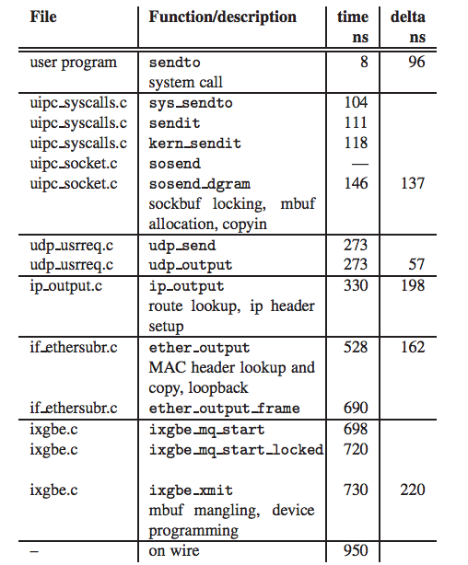
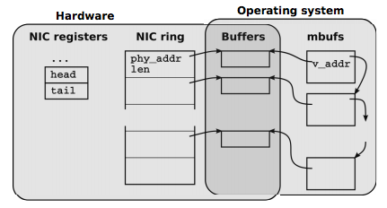
Overhead
http://info.iet.unipi.it/~luigi/papers/20120503-netmap-atc12.pdf

Slide 8
Current available primitives
High-performance IO library
DPDK
Netmap
Rapid development
Click: compose-able programming framework

Slide 9
Simple Forwarding to Network Control Functions: Network Address Translation
A local network uses just one public IP address as far as outside world is concerned
Each device on the local network is assigned a private IP address
rest of
Internet
local network
(e.g., home network)
192.168.1.0/24
192.168.1.2
192.168.1.1
192.168.1.3
138.76.29.7
192.168.1.4
NAT gateway replaces source address with NAT IP address (e.g., 138.76.29.7)
different source port numbers
All datagrams leaving local network cannot use private address use source address.

Slide 10
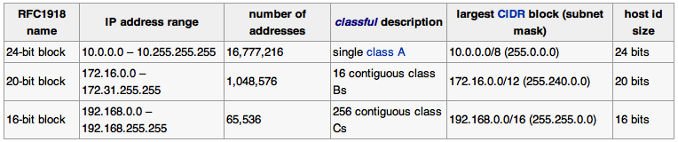
Private IP

Slide 11
NAT: Network Address Translation
Implementation: NAT router must:
outgoing datagrams: replace (source IP address, port #) of every outgoing datagram to (NAT IP address, new port #)
. . . remote clients/servers will respond using (NAT IP address, new port #) as destination addr.
remember (in NAT translation table) every (source IP address, port #) to (NAT IP address, new port #) translation pair
incoming datagrams: replace (NAT IP address, new port #) in dest fields of every incoming datagram with corresponding (source IP address, port #) stored in NAT table

Slide 12
NAT: Network Address Translation
NAT translation table
WAN side addr LAN side addr
1: host 192.168.1.2
sends datagram to
128.119.40.186, 80
2: NAT router
changes datagram
source addr from
192.168.1.2, 3345 to
138.76.29.7, 5001,
updates table
138.76.29.7, 5001 192.168.1.2, 3345
…… ……
S: 192.168.1.2, 3345
D: 128.119.40.186, 80
192.168.1.2
1
2
S: 138.76.29.7, 5001
D: 128.119.40.186, 80
192.168.1.1
192.168.1.3
138.76.29.7
S: 128.119.40.186, 80
D: 192.168.1.2, 3345
4
S: 128.119.40.186, 80
D: 138.76.29.7, 5001
3
192.168.1.4
4: NAT router
changes datagram
dest addr from
138.76.29.7, 5001 to 192.168.1.2, 3345
3: Reply arrives
dest. address:
138.76.29.7, 5001

Slide 13
Network Address Translation: Advantages
No need to be allocated range of addresses from ISP: - just one public IP address is used for all devices
16-bit port-number field allows 60,000 simultaneous connections with a single LAN-side address !
can change ISP without changing addresses of devices in local network
can change addresses of devices in local network without notifying outside world
Devices inside local net not explicitly addressable, visible by outside world (a security plus)

Slide 14
Network Address Translation: Problems
If both hosts are behind NAT, they will have difficulty establishing connection
NAT is controversial:
routers should process up to only layer 3
violates end-to-end argument
NAT possibility must be taken into account by app designers, e.g., P2P applications
address shortage should instead be solved by having more addresses --- IPv6 !

Slide 15
Implication of Implementing NAT
NAT translation table
WAN side addr LAN side addr
138.76.29.7, 5001 192.168.1.2, 3345
…… ……
S: 192.168.1.2, 3345
D: 128.119.40.186, 80
192.168.1.2
1
2
S: 138.76.29.7, 5001
D: 128.119.40.186, 80
192.168.1.1
192.168.1.3
138.76.29.7
S: 128.119.40.186, 80
D: 192.168.1.2, 3345
4
S: 128.119.40.186, 80
D: 138.76.29.7, 5001
3
192.168.1.4
Routing table no longer looks up by dest. IP, but also dest. Port
Network needs to conduct packet transformation, beyond simple lookup

Slide 16
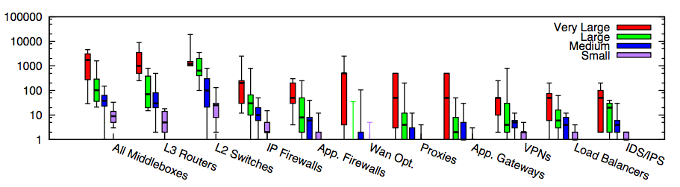
Simple Forwarding to Network Functions: Enterprise Networks
Modern networks contain diverse types of equipment beyond simple routing/forwarding
Enterprise networks
Small: <=1k hosts; Medium: 1k-10k; Large: 10k-100k; Very Large: >= 100k
Source: [Sherry, et. al SIGCOMM’12]

Slide 17

Enterprise/Cloud Structure
Internet
CE
F₂
F₁ (Firewall)
R₁
S₂
S₁
LB₂
LB₁ (Load balancer)
IPS₃
IPS₂
IPS₁(Intrusion prevention)
S₆
S₅
S₄
S₃
tier-1
VLAN 200
VLAN 100
VLAN 300
VLAN 400
Logger
Tier-3
Tier-2
Tier-1

Slide 18
Linux FW (iptable)

Slide 19
Simple Forwarding to Network Functions
OpenStack using OVS

Slide 20
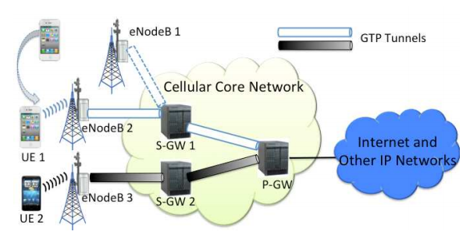
Simple Forwarding to Network Control Functions: Mobile Networks
Modern networks contain diverse types of equipment beyond simple routing/forwarding
LTE Architecture

Slide 21
Outline
Admin and recap
Link layer
Software defined networking
Motivation: from simple forwarding to network functions
Design overview

Slide 22
Alternative Design: Software Defined Networking
Instead of distributed computing, directly setting up the state of network devices.
Instead of distributed computing, setting up the state of network selected devices.
i
a
b
e
f
g
d
c
h
Discussion: key components of the architecture?

Slide 23

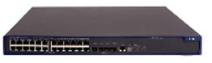
SDN Data Path Designs
SDN
Control
OpenFlow
NetConf RestConf
SNMP
Forces
…
Datapath
Datapath
Datapath model: - OpenFlow1.x - OFDPA - P4 - POF
…
Datapath

Slide 24
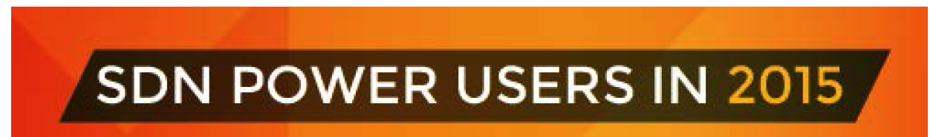
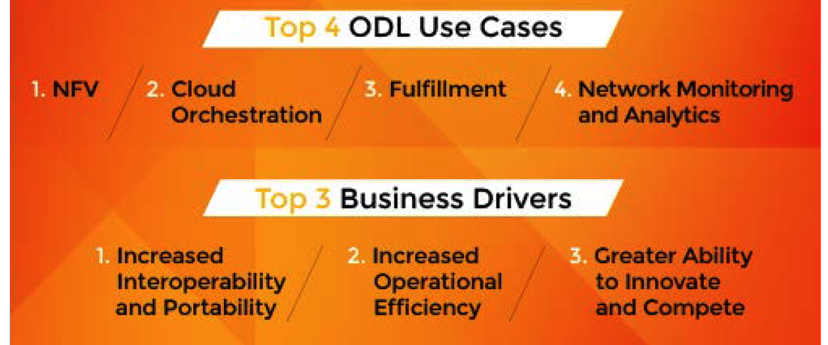
SDN Use Cases
Source: Neela Jacques, July 2015.

Slide 25
Outline
Admin and recap
Link layer
Software defined networking
Motivation: from simple forwarding to network functions
Design overview
Data path (OpenFlow)

Slide 26
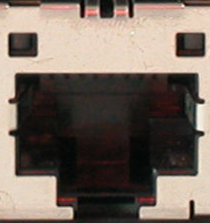
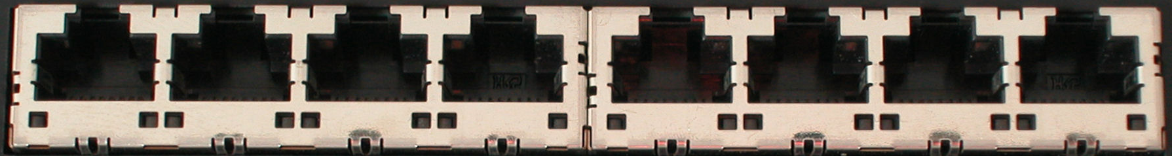
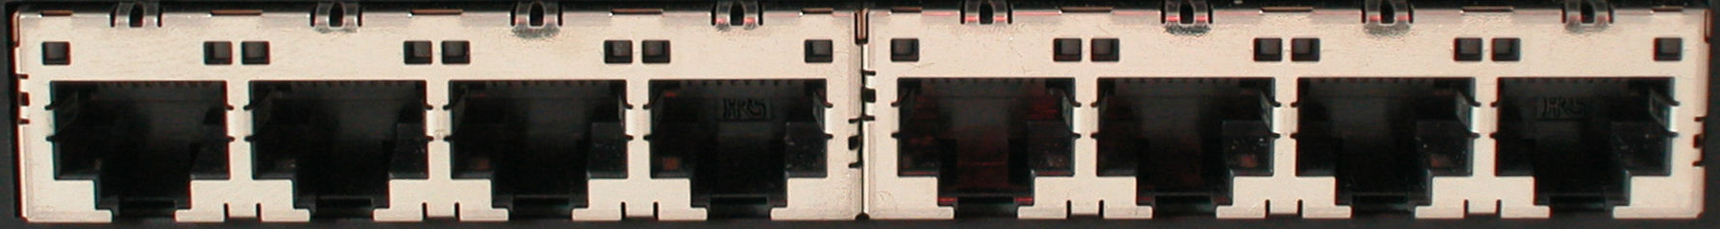

OpenFlow Datapath
Ethernet Switch
port 1
port 2
port 3
port 4
5.6.7.8
1.2.3.4

Slide 27
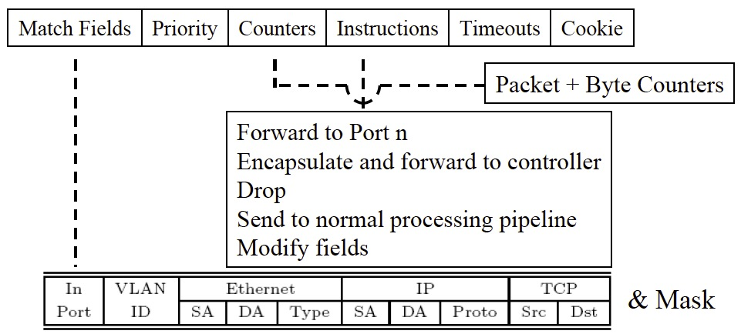
OpenFlow Datapath
Controller
OpenFlow Firmware
Software
Layer
PC
Flow Table
Hardware
Layer
port 1
port 2
port 3
port 4
5.6.7.8
1.2.3.4

Slide 28
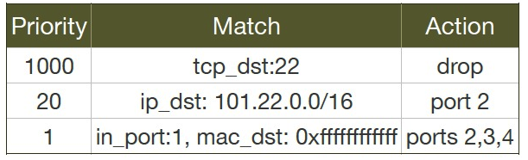
Datapath Model: OpenFlow

Slide 29
OpenFlow Datapath: Example
Controller
OpenFlow Firmware
PC
Software
Layer
Flow Table
MAC
src
MAC
dst
IP
Src
IP
Dst
TCP
sport
TCP
dport
Action
Hardware
Layer
*
*
*
5.6.7.8
*
*
port 1
port 1
port 2
port 3
port 4
5.6.7.8
1.2.3.4

Slide 30
OpenFlow Datapath: Examples
Switching
Switch
Port
MAC
src
MAC
dst
Eth
type
VLAN
ID
IP
Src
IP
Dst
IP
Prot
TCP
sport
TCP
dport
Action
*
*
00:1f:..
*
*
*
*
*
*
*
port6
Flow Switching
Switch
Port
MAC
src
MAC
dst
Eth
type
VLAN
ID
IP
Src
IP
Dst
IP
Prot
TCP
sport
TCP
dport
Action
port3
00:20..
00:1f..
0800
vlan1
1.2.3.4
5.6.7.8
4
17264
80
port6
Firewall
Switch
Port
MAC
src
MAC
dst
Eth
type
VLAN
ID
IP
Src
IP
Dst
IP
Prot
TCP
sport
TCP
dport
Forward
*
*
*
*
*
*
*
*
*
22
drop

Slide 31
OpenFlow Datapath: Examples
Routing
Switch
Port
MAC
src
MAC
dst
Eth
type
VLAN
ID
IP
Src
IP
Dst
IP
Prot
TCP
sport
TCP
dport
Action
*
*
*
*
*
*
5.6.7.8
*
*
*
port6
VLAN Switching
Switch
Port
MAC
src
MAC
dst
Eth
type
VLAN
ID
IP
Src
IP
Dst
IP
Prot
TCP
sport
TCP
dport
Action
port6,
port7,
port9
*
*
00:1f..
*
vlan1
*
*
*
*
*

Slide 32


OpenFlow Message Flows: Reactive Mode (pkt miss)
Controller
OpenFlow
Switch
PC
Rule
Action
Statistics
OpenFlow
Protocol pkt miss msg
OpenFlow
Switch
OpenFlow
Switch
flowtable lookup miss
Rule
Action
Statistics
Rule
Action
Statistics
pkt
OpenFlowSwitch.org
Notes:
32
32

Slide 33
OpenFlow Message Flows: Reactive Mode (flow mod)
Controller
pkt_miss handler
OpenFlow
Switch
PC
Rule
Action
Statistics
OpenFlow
Protocol flow_mod
OpenFlow
Switch
OpenFlow
Switch
pkt
Rule
Action
Statistics
Rule
Action
Statistics
OpenFlowSwitch.org
Notes:
33
33

Slide 34
OpenFlow Message Flows: Reactive Mode (forward)
Controller
OpenFlow
Switch
PC
Rule
Action
Statistics
OpenFlow
Switch
OpenFlow
Switch
pkt
Rule
Action
Statistics
Rule
Action
Statistics
OpenFlowSwitch.org
Notes:
34
34

Slide 35
Outline
Admin and recap
Link layer
Software defined networking
Motivation: from simple forwarding to network functions
Design overview
Data path (OpenFlow)
Control path (programming model)

Slide 36

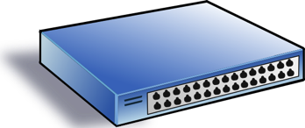
SDN Programming Model
Service/ Policy
Program Logic
Datapath Model
Datapath Model
Network State

Slide 37


An Example: A Simple SDN Controller
badPort = 22 // policy hostTbl = {A:1,B:2, C:3,D:4} // net view
def onPacketIn(p):
if badPort == p.tcp_dst: drop
else: forward([hostTbl(p.eth_dst)])
1
2
3
4
A
B
C
D
Assume only packets to A,B,C,D can appear.

Slide 38
Controller Program with Flow Table Management
hostTbl = {A:1,B:2,C:3,D:4}
def onPacketIn(p):
if 22 == p.tcp_dst: drop
installRule({‘match':{'tcp_dst':22}, ‘action’:[]})
else: forward([hostTbl(p.eth_dst)])
installRule({‘match’: {‘eth_dst’:p.eth_dst, ’tcp_dst’!=22},
‘action’:[hostTbl(p.eth_dst)]})
match does not support logic negation

Slide 39
Controller Program with Flow Table Management
hostTbl = {A:1,B:2,C:3,D:4}
def onPacketIn(p):
if 22 == p.tcp_dst: drop
installRule({‘priority’:1, ‘match’:{'tcp_dst':22}, ‘action’:[]})
else: forward([hostTbl(p.eth_dst)])
installRule({‘priority’:0, ‘match’: {‘eth_dst’:p.eth_dst},
‘action’:[hostTbl(p.eth_dst)]})

Slide 40
Does the Program Work?
Switch
EthDst:A,
TcpDst:80
{`priority`:0,’match’:{‘eth_dst’:A},'action':[1]}
EthDst:A,
TcpDst:22
A security bug!
Controller
def onPacketIn(p):
if 22 == p.tcp_dst: drop
installRule({`priority`:1,’match’:{‘tcp_dst':22},'action':[]})
else:
installRule({`priority`:0,’match’:{‘eth_dst’:p.eth_dst},
'action':[hostTbl(p.eth_dst)]})
forward([hostTbl(p.eth_dst)])
Notes:
Unfortunately, this program has a bug. To see where the program goes wrong, let’s watch what happens when we connect this controller to a single switch and let two packets arrive. Both packets have destination mac A. The red packet is to TCP destination 80, while the green packet is to TCP destination 22. When the red packet arrives, the switch has an empty flow table and sends the packet to the controller. The controller determines that the packet should be forwarded to the next hop, and installs the appropriate rule. The red packet returns to the switch and moves onward. Now, the port 22 packet arrives at the switch, and instead of being dropped or sent to the controller, it matches the low priority rule for Ethernet destination A and is therefore forwarded onward. This violates the user’s intentions and may represent a security violation.

Slide 41
OVS Approach: Using Exact Match
hostTbl = {A:1,B:2,C:3,D:4}
def onPacketIn(p):
if 22 == p.tcp_dst: drop
installRule({‘priority’:1, ‘match’:exactMatch(p), ‘action’:[]})
else: forward([hostTbl(p.eth_dst)])
installRule({‘priority’:0, ‘match’:exactMatch(p),
‘action’:[hostTbl(p.eth_dst)]})

Slide 42
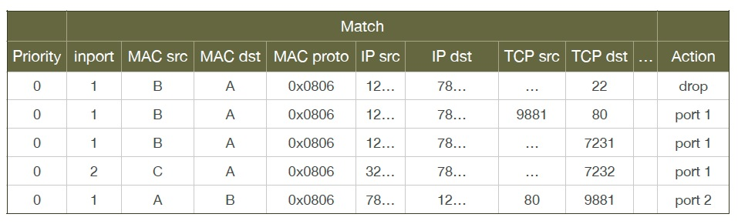
Problems of OVS Approach
Each new TCP flow delayed for flow setup (10-100 ms)
Number of flow table rules may exceed capacity (typically a few thousands)

Slide 43
Outline
Admin and recap
Link layer
Software defined networking
Motivation: from simple forwarding to network functions
Design overview
Data path (OpenFlow)
Control path (programming model)
Problems
Algorithmic network programming

Slide 44
Goal of SDN Programming
Let programmers write the most obvious (=> data path independent) code:
Design a system that can automatically generate correct, highly-optimized data path.
def onPacketIn(p) if 22 == p.tcp_dst: drop
else: forward([hostTbl(p.eth_dst)])

Slide 45
Algorithmic SDN Programming Abstraction: Programmer’s View
Conceptually programmer’s network control function f is invoked on every packet entering the network.
f expressed in an existing, general purpose language (e.g., Java, Python), describing how a packet should be routed, not how data path flow tables are configured
f: packet route

Slide 46
Example Algorithmic Policy in Java
Route f(Packet p) {
if (p.tcpDstIs(22)) return null();
else {
Location sloc = hostTable(p.ethSrc());
Location dloc = hostTable(p.ethDst());
Route path = myRoutingAlg(topology(), sloc,dloc);
return path;
}
}
Route myRoutingAlg(Topology topo, Location sLoc, Location dloc) {
if ( isSensitive(sLoc) || isSensitive(dLoc) ) return secureRoutingAlg(topo, sloc, dloc);
else return standardRoutingAlg(topo, sloc, dloc);
}
Does not specify anything on flow tables!
Notes:
Here is an example algorithmic program, written in Java.
Explain program.
Note that the program does not specify flow table configuration.
So the programming model makes the programmer’s life easy: just take a packet and say what to do with it.

Slide 47
More Complex Example: ACL+Routing
void insert(ACLItem acl, int pos, List<ACLItem> acls) {
acls.add(pos, acl);
}
void delete(int pos, List<ACLItem> acls) {
acls.remove(pos);
}
boolean permit(Packet p, List<ACLItem> acls) {
for (ACLItem item : acls) {
if ( match(p, item) ) {
return item.action == PERMIT;
} }
return false;
}
List<ACLItem> acls;
Route f(Packet p) {
if ( ! permit(p, acls) ) {
return null();
}
Location sloc = hostTable(p.ethSrc());
Location dloc = hostTable(p.ethDst());
Route path = myRoutingAlg(topology(),sloc,dloc);
return path;
}

Slide 48
Challenge and Basic Idea
Challenge: How to derive datapath (flow-tables) from a datapath-oblivious SDN controller function f?
Basic idea of handling the challenge w/o a compiler:
There are two representations of computation
A sequence of instructions (whitebox)
Memorization tables (blackbox)
Although the decision function f does not specify how flow tables are configured, if for a given decision (e.g., drop), one know the dependency of the decision, one can construct the flow tables (aka, memorization tables).
Notes:
On the other hand implementing algorithmic policies is challenging.
We know that naive solutions -- process every packet at controller or use only exact match rules -- perform poorly.
Static analysis to determine layout of flow tables is possible, but has drawbacks; in particular static analysis of general purpose language programs is typically conservative. Furthermore, relying on static analysis will cause the system to become substantially dependent on the source language in which we write algorithmic policies.

Slide 49
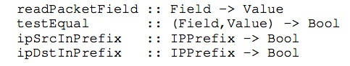
Basic Idea
Only requirement: Program f uses a simple library to access pkt attributes:
Library provides both convenience and more importantly, decision dependency!

Slide 50
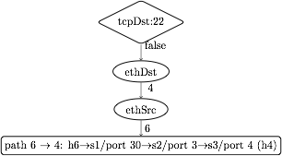
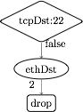
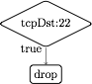
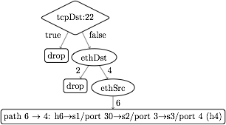
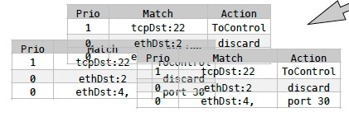
Dynamic Tracing: Abstraction to Flow Tables
1. Observes decision dependency of f on pkt attributes.
2. Builds a trace tree (TT), a universal (general), partial decision tree representation of any f.
3. Compile trace tree to generate flow tables (FTs).
Notes:
Instead, we introduce Maple, a system that implements algorithmic policies using a fully dynamic compilation method and which does not depend on the source language used to express the algorithmic policy.
Maple works by repeatedly executing the user’s algorithmic policy f on packets entering the network, generalizing the outcome to other packets by observing traces of data accesses made during the execution.
Maple then accumulates these traces into a trace tree, which is a partial decision tree of the input algorithmic policy, f.
Finally, Maple compiles flow tables (FTs) for all the switches in the network from the trace tree. The compilation is done so that packets for which Maple has not yet successfully inferred a forwarding decision are sent back to the controller to ensure that Maple continues to execute f and refine its trace tree.

Slide 51
Policy
EthSrc:1,
EthDst:2,
TcpDst:80
Route f(Packet p) {
if (p.tcpDstIs(22))
return null();
else {
Location sloc =
hostTable(p.ethSrc());
Location dloc =
hostTable(p.ethDst());
Route path =
myRoutingAlg(
topology(),sloc,dloc);
return path;
}
}
Assert: TcpDst==22
false
Read: EthSrc
1
Read: EthDst
2
path1
Notes:
We use the example Java algorithmic policy to illustrate the tracing method. Suppose Maple executes the algorithmic policy on a packet with Ethernet source 1, Ethernet dest 2 and tcp destination 80. As the packet moves through the policy, Maple collects a trace of the execution.
When this packet arrives at the check on tcp destination, Maple records the assertion, and its outcome. In this case, the outcome is false. The program proceeds to the else branch, where it reads the source and destination addresses, both of which Maple logs. Finally, the program returns the computed path.

Slide 52
Policy
Trace Tree
EthDst:1,
TcpDst:22
Route f(Packet p) {
if (p.tcpDstIs(22))
return null();
else {
Location sloc =
hostTable(p.ethSrc());
Location dloc =
hostTable(p.ethDst());
Route path =
myRoutingAlg(
topology(),sloc,dloc);
return path;
}
}
Assert: TcpDst==22
Assert: TcpDst==22
true
null
true
false
Read: EthSrc
?
1
Read: EthDst
2
path1
Notes:
Maple then uses this trace to begin generating the Trace Tree. In this case, Maple still doesn’t know what will happen if the assertion is true, and it therefore adds a placeholder under the true branch.
Now, if we execute f on a packet to tcp destination 22, the assertion is true, and the packet is dropped. Maple logs this new trace and uses it to refine its Trace Tree, filling in the true branch of the assertion.

Slide 53
Policy
Trace Tree
EthDst:1,
TcpDst:22
Route f(Packet p) {
if (p.tcpDstIs(22))
return null();
else {
Location sloc =
hostTable(p.ethSrc());
Location dloc =
hostTable(p.ethDst());
Route path =
myRoutingAlg(
topology(),sloc,dloc);
return path;
}
}
Assert: TcpDst==22
Assert: TcpDst==22
true
null
true
false
Read: EthSrc
null
1
Read: EthDst
2
path1
Notes:
Maple then uses this trace to begin generating the Trace Tree. In this case, Maple still doesn’t know what will happen if the assertion is true, and it therefore adds a placeholder under the true branch.
Now, if we execute f on a packet to tcp destination 22, the assertion is true, and the packet is dropped. Maple logs this new trace and uses it to refine its Trace Tree, filling in the true branch of the assertion.

Slide 54
Trace Tree Formal Spec
Assert: TcpDst==22
A tree w/ 4 types of nodes
T node: assertion on packet attributes
V node: multi-way branching on a packet attribute
L node: leaf node labeled w/ action
? node: unknown
TT search: traverse tree for a given packet to determine action or no answer
TT correctness: if TT records an answer for a given packet, the answer is the same as the original algorithm
true
false
Read: EthSrc
?
1
Read: EthDst
2
path1

Slide 55
Trace Tree => Flow Table
tcpDst ==22
True
False
drop
ethDst
match:{tcpDst==22}
4
2
drop
ethSrc
match:{tcpDst!=22, ethDst:2}
6
port 30
match:{tcpDst!=22, ethDst:4,ethSrc:6}
Notes:
The basic compilation algorithm is actually very simple, and we explain it here in the context of an example trace tree. For simplicity the leaves are labeled with switch-specific actions, such as forward on some ports or drop.
The basic algorithm generates one rule for each execution of f, and each execution of f is stored as a path from the root of the trace tree to a leaf. For example, the right-most path in this tree resulted from an execution that observed that tcpDst!=22 and ethDst==4 and ethSrc==6.
The leaf stores the action and the match condition can be obtained from the path from the root to the leaf. In this case, we would want to match on tcpDst!=22, ethDst==4 and ethSrc==6. Of course, as we described earlier, we cannot match on tcpDst!=22, and so instead we will generate a rule at some higher priority that matches on the condition which we wish to negate. This rule, which we call a “barrier rule” ensures that the rule for the execution which we are considering only fires when the condition is false.
We observe that all the rules that require tcpDst!=22 are under the False branch of the assertion node and all the rules that require tcpDst==22 are under the True branch of the assertion node. Therefore, we can determine the priority level of the barrier rule by first generating rules and assigning priorities to the False branch of the node, and then assigning the priority of the barrier rule to have the next higher priority. Then we can assign priorities to the True branch. Hence, by generating rules in-order from False to True, we can correctly assign priorities to rules.
Finally, since the subtree under the True branch may not completely describe how to handle all tcpDst==22 packets, some packets with tcpDst==22 may fall through to the reach the barrier rule. Therefore, the action for the barrier rule must be ToController, so that we can continue to trace f correctly.

Slide 56
Trace Tree => Flow Table
tcpDst ==22
True
False
drop
ethDst
match:{tcpDst==22}
4
2
drop
ethSrc
match:{tcpDst!=22, ethDst:2}
6
port 30
barrier rule:
match:{tcpDst!=22, ethDst:4,ethSrc:6}
match:{tcpDst==22}
action:ToController
_{Priority}

Slide 57
Trace Tree => Flow Table
Simple, classical in-order tree traversal generates flow table rules!
tcpDst ==22
3
1
True
False
2
ethDst
drop
match:{tcpDst==22}
4
2
drop
ethSrc
match:{tcpDst!=22, ethDst:2}
6
port 30
barrier rule:
match:{tcpDst!=22, ethDst:4,ethSrc:6}
match:{tcpDst==22}
action:ToController
_{Priority}

Slide 58
Admin
Mini-projects
Please limit the scope
Open office hours:
Thursday 2:30 – 3:30 pm
Friday: 1:00 – 3:00 pm
Monday: 10:00 – 1:00 pm
Any feedback/suggestions on the course will be appreciated.

Slide 59
Course Topics Summary
The Internet is a general-purpose, large-scale, distributed computer network
Major design features/principles
packet switching/statistical multiplexing
time-reversibility, queueing theory and performance analysis
layered architecture, hour-glass architecture
end-to-end principle
decentralized (social-technocal) architecture
e.g., DNS (hierarchy delegation), interdomain routing (peer-to-peer)
resource allocation framework
axiom-based design (NBS); optimization decomposition through duality
adaptive control
e.g., sliding window self clocking, AIMD adaptation, Ethernet exp backoff
tradeoff between theoretical impossibility and practice

Slide 60

First-Day Class: What is a Network Protocol?
A network protocol defines the format and the order of messages exchanged between two or more communicating entities, as well as the actions taken on the transmission and/or receipt of a message or other events.
Protocols that we have touched on?

Slide 61
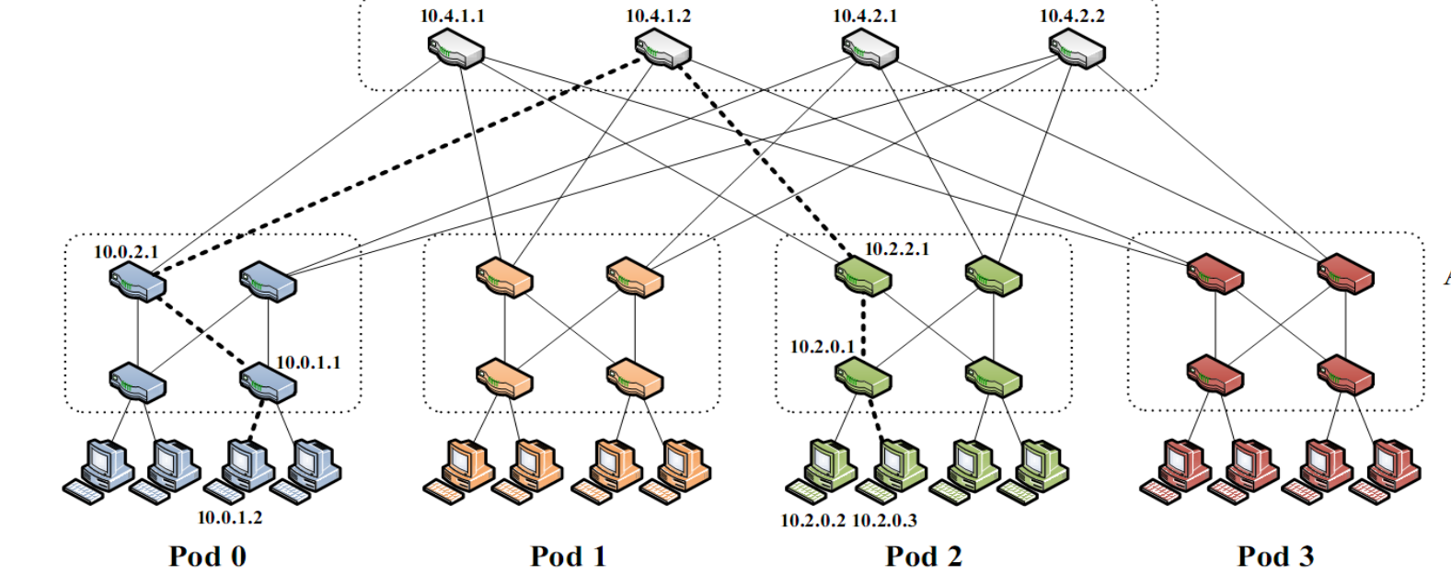
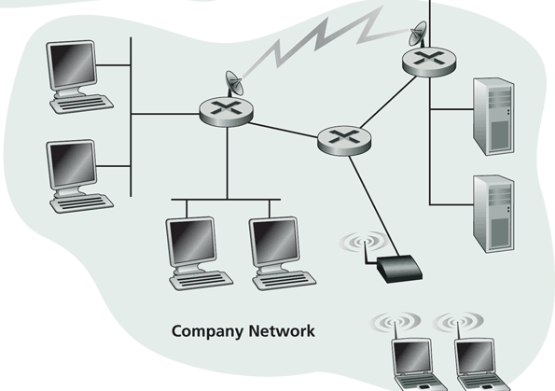
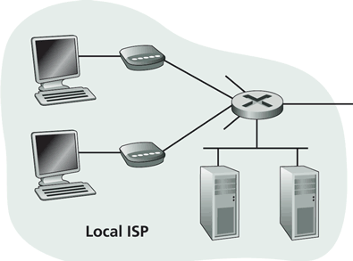
First-Day Class: Internet Physical Infrastructure
Residential access
Cable, Fiber, DSL, Wireless
ISP
Backbone ISP
ISP
The Internet is a network of networks
Each individually administrated network is called an Autonomous System (AS)
data center
Campus access, e.g.,
Ethernet
Wireless
https://www.google.com/loon/how/

Slide 62
First-Day Class: General Complexity
Complexity in highly organized systems arises primarily from design strategies intended to create robustness to uncertainty in their environments and component parts.
Scalability is robustness to changes to the size and complexity of a system as a whole.
Evolvability is robustness of lineages to large changes on various (usually long) time scales.
Reliability is robustness to component failures.
Efficiency is robustness to resource scarcity.
Modularity is robustness to component rearrangements.
David Meyer

Slide 63
First-Day Class: Evolution
Driven by Technology, Infrastructure, Policy, Applications (usage), and Understanding:
technology
e.g., wireless/optical communication technologies and device miniaturization (sensors)
infrastructure
e.g., cloud computing vs local computing
applications (usage)
e.g., mobile computing, content distribution, game, tele presence, sensing
understanding
e.g., resource sharing principle, routing principles, mechanism design, optimal stochastic control (randomized access)
Complexity comes from evolution.
Don’t be afraid to challenge the foundation and redesign!

Slide 64
Faster (Higher-BW)

Slide 65
Basic Theory: Channel Capacity
The maximum number of bits that can be transmitted per second (bps) by a physical media is:
where W is the frequency range, S/N is the signal noise ratio. We assume Gaussian noise.

Slide 66
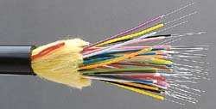
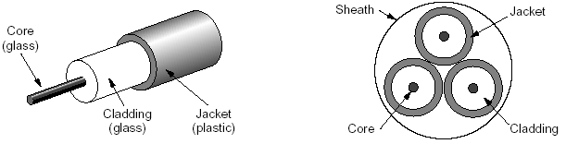
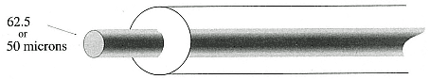
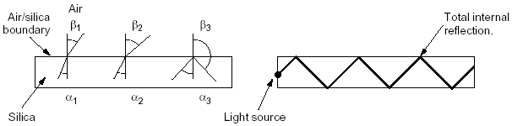
The Wire: Fiber
A look at a fiber
How it works?
A graded index fiber

Slide 67
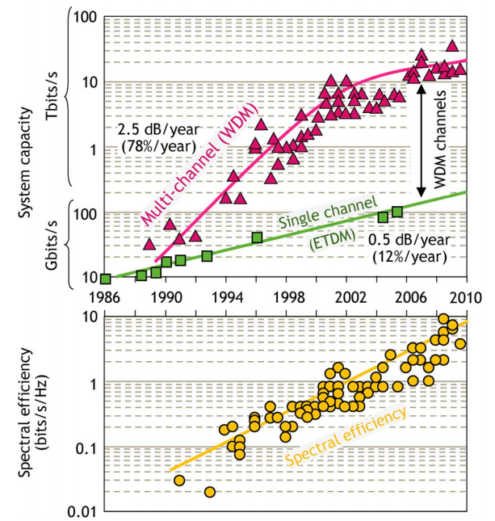
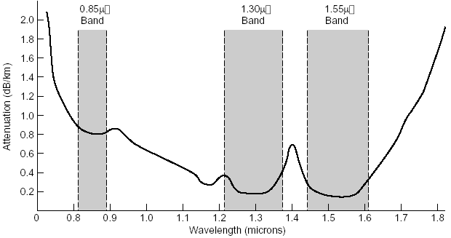
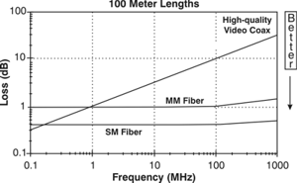
The Wire: Fiber
Wide spectrum (large W) at low loss (high S/N): ~0.3db/km (c.f. copper ~190db/km @100Mhz), 30-100km without repeater
Lightweight: 33 tons of copper to transmit the same amount of information carried by ¼ pound of optical fiber
Capacity Limits of Optical Fiber Networks
http://ieeexplore.ieee.org/stamp/stamp.jsp?tp=&arnumber=5420239

Slide 68
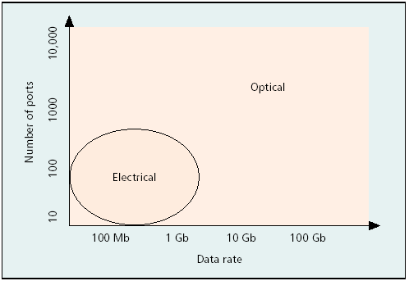
Advantages of Fibers

Slide 69
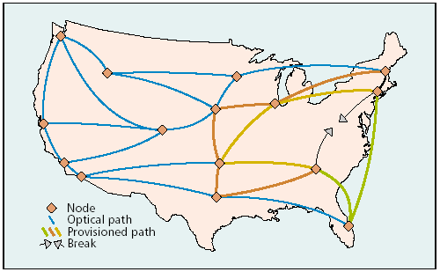
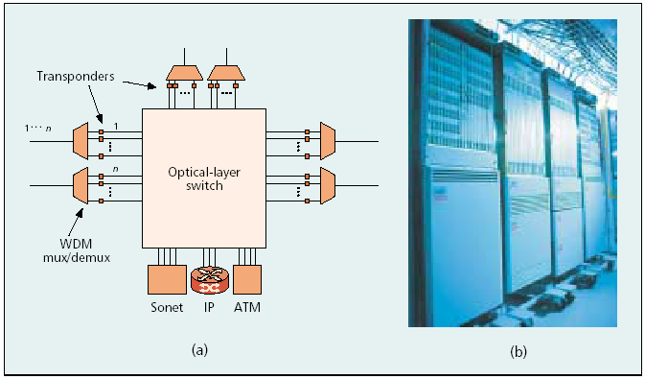
How to Do Switching?
Optical-Electrical-Optical
Optical switch: optical micro-electro-mechanical systems (MEMS)
Optical path
One optical switch
http://www.qwest.com/largebusiness/enterprisesolutions/networkMaps/preloader.swf

Slide 70
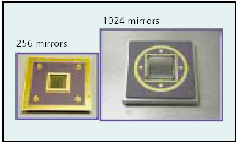
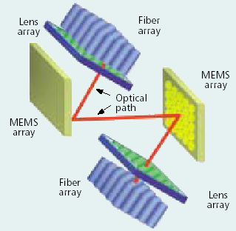
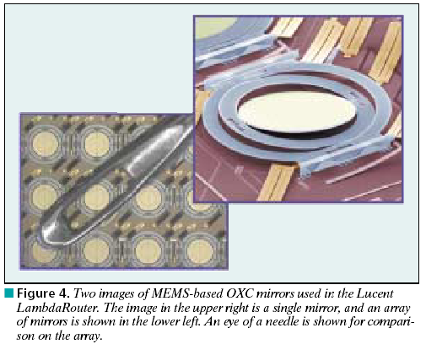
Example: MEMS Optical Switch
Using mirrors, e.g. Lambda Router

Slide 71
Implications
Fine-grained switching may not be feasible
What is the architecture of optical networks: packet switching, circuit switching, or others?

Slide 72
More Reliable

Slide 73

Is the Internet Reliable?
A key design objective of the “Internet” (i.e., packet-switched networks) is robustness
Does the Internet infrastructure achieve the target reliability objective of a highly reliable system (99.999%)?

Slide 74
Perspective
911 Phone service (1993 NRIC report +)
29 minutes per year per line
99.994% availability
Std. Phone service (various sources)
53+ minutes per line per year
99.99+% availability
…what about the Internet?
Various studies: about 99.5%
Need to reduce down time by 500 times to achieve five nines; 50 times to match phone service

Slide 75
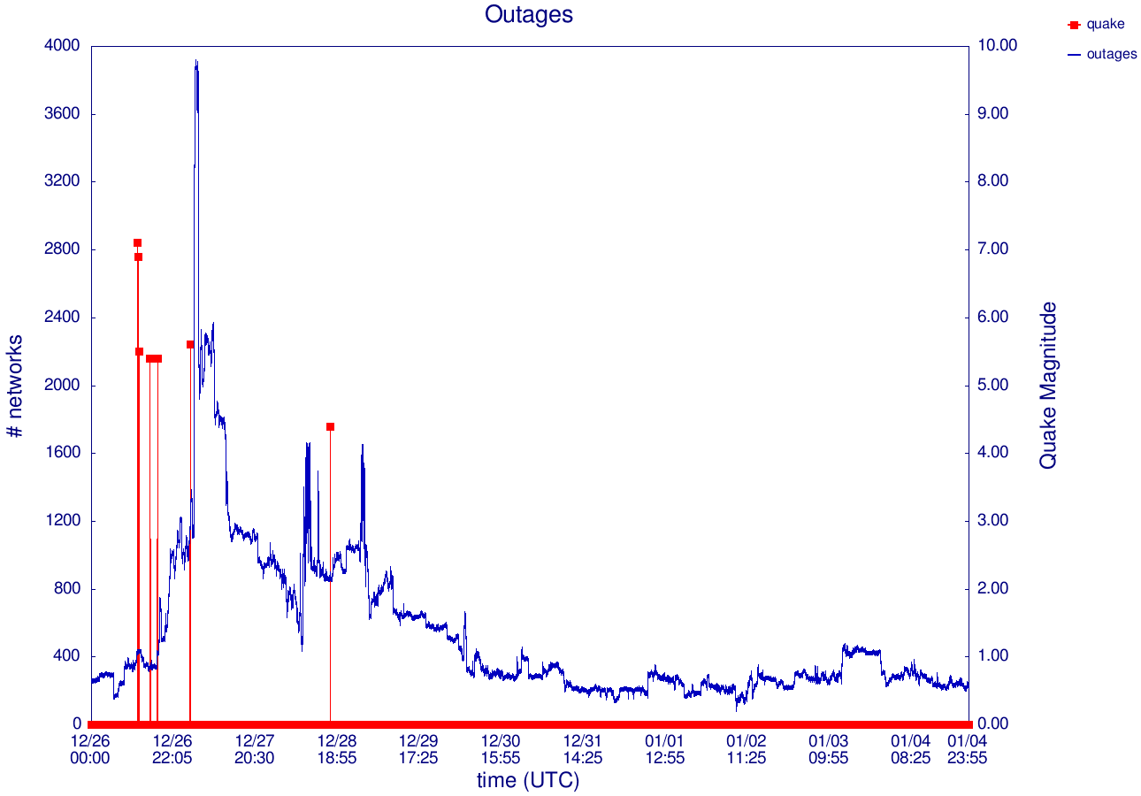
Unreachable Networks: 10 days

Slide 76
Internet Disaster Recovery Response
Why slow response?
the cable repairing is slow: not until 21 days after quake
BGP is not designed to create business relationship
Possibility
a meta-BGP to facilitate discovery and creation of BGP business relationship

Slide 77
Virtualized (Cloud)

Slide 78
Example: OpenStack
Network API (http://developer.openstack.org/api-ref-networking-v2.html)
POST /v2.0/networks
POST /v2.0/subnets
POST /v2.0/ports
…
DNS API (https://developer.openstack.org/api-ref/dns/)
Load Balancer API (https://developer.openstack.org/api-ref/load-balancer/v2/)
NFV Orchestration API (https://developer.openstack.org/api-ref/nfv-orchestration/v1/)

Slide 79
Comment
The APIs are very simple at this point
The key challenge is to implement the APIs using scripts

Slide 80
Smarter Apps

Slide 81
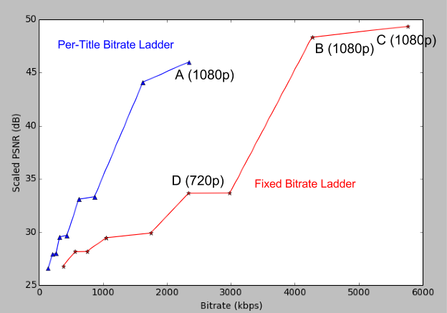
Example: Change the Rate of an MM Application
Adaptive HTTP streaming is widely used
Video and audio
can generate different encoding rates by controlling the encoding process
Question: how do you change the rate of a multimedia stream?
http://techblog.netflix.com/2015/12/per-title-encode-optimization.html

Slide 82

Video Encoding: Block Transform Encoding (First Step)
DCT

Slide 83
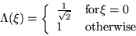
Discrete Cosine Transform
- Convert from pixel domain to frequency domain
- DCT better at reducing redundancy than Discrete Fourier Transform but it is more computationally expensive

Slide 84

Basis Functions of DCT

Slide 85
Video Encoding: Block Transform Encoding (All)
DCT
Zig-zag
Quantize
011010001011101...
Run-length Code
Huffman Code

Slide 86
Example: Block Encoding
DC component
Quantize
DCT
original image
AC components
zigzag
run-length
code
Huffman
code
10011011100011...
coded bitstream < 10 bits (0.55 bits/pixel)

Slide 87
Result of Coding/Decoding
original block
reconstructed block
errors

Slide 88



Examples
Uncompressed (262 KB)
Compressed (22 KB, 12:1)
Compressed (6 KB, 43:1)

Slide 89
Encode Rate According to Available Bandwidth
Steps
Estimate available bandwidth (how?)
Encode the stream according to the estimation of available bandwidth (how?)

Slide 90
More Efficient Net/App

Slide 91
Problem: Inefficient Interactions
Large deployment of highly adaptive, multipoint applications
An iterative process between two sets of adaptation:
ISP: traffic engineering to change routing to shift traffic away from higher utilized links
current traffic pattern ➔ new routing matrix
App: direct traffic to better performing end points
current routing matrix ➔ new traffic pattern

Slide 92
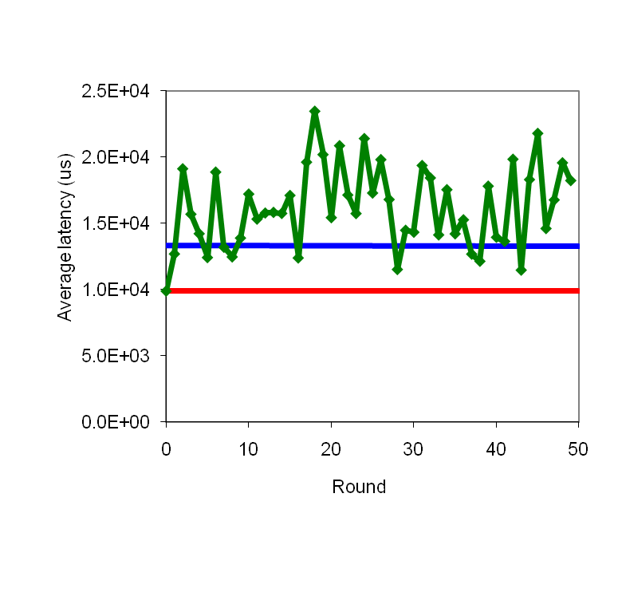
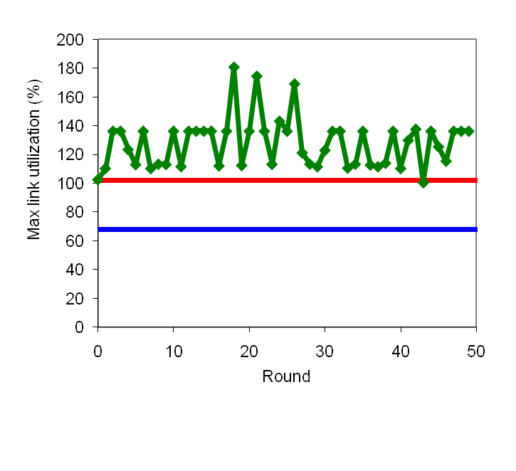
ISP Traffic Engineering+ App Latency Optimizer
red: App adjust alone; fixed ISP routing
blue: ISP traffic engineering adapt alone; fixed App communications
ISP optimizer interacts poorly with App.
Notes:
red p2p alone
blue: TE alone

Slide 93
A Fundamental Problem
Internet architectural feedback to application efficiency is limited:
routing (hidden)
rate control through coarse-grained TCP congestion feedback
To achieve better efficiency, needs explicit communications between network resource providers and applications

Slide 94
Example App Objective
For example, optimize completion time =>
maximizing up/down link capacity usage
Notes:
Need to also add tit-for-tat and other constraints

Slide 95
Example Network Objective
ISP Objective
Minimize MLU
Notations:
Assume K applications in the ISP’s network
b_{e}: background traffic volume on link e
c_{e}: capacity of link e
I_{e}(i,j) = 1 if link e is on the route from i to j
t^{k} : a traffic demand matrix {t^{k}_{ij}} for each pair of nodes (i,j)

Slide 96
System Formulation
Combine the objectives of net and applications
s.t., for any k,
T¹
t^{k}
T^{k}

Slide 97
Possible Solution
s.t., for any k,
A straightforward approach: centralized solution
Issues
Not application-agnostic
Not scalable

Slide 98
Constraints Couple Entities
Constraints couple net/app together!

Slide 99
Objective: Decouple Net/Apps
t^{k}
Introduce p_{e} to decouple the constraints
T^{k}
p_{e}

Slide 100
MLU: Dual
With dual variable p_{e} (≥ 0) for the inequality of each link e
To make the dual finite, need

Slide 101
MLU: Dual
Then the dual is
where p_{ij} is the sum of p_{e} along the path from node i to node j

Slide 102
Net/App Interactions
The interface between applications and providers is the dual variables {p_{ij}}
p_{e1}(t)
p_{e2}(t)
t^{k}(t)

Slide 103
Questions to Think About
Does the proceeding work for general applications?
Overall, how to make OTT apps (e.g., Netflix, facebook) more efficient?

Slide 104
Mobility First

Slide 105
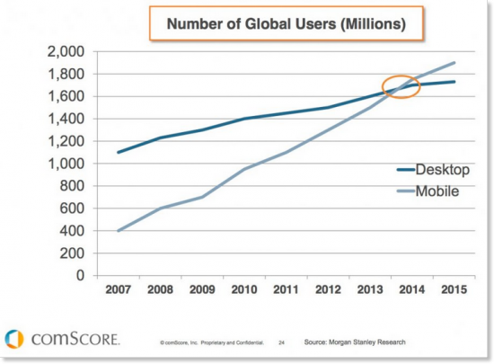
Shift of Computing Devices

Slide 106
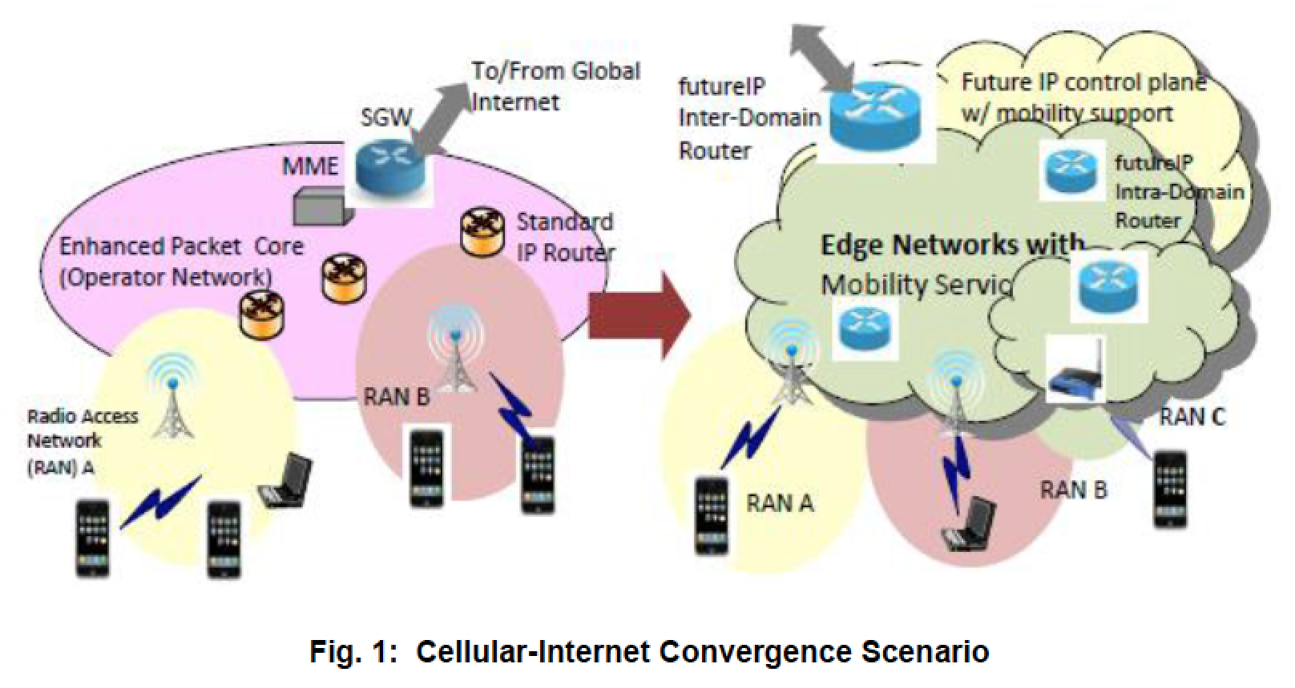
Network Architecture Convergence
Internet+Cellular
Unified Mobile Internet
Issues of the Internet under mobility
Notes:
IP addresses represent locations (attachment points to networks) and hence mobility causes changes of attachment points and addresses

Slide 107
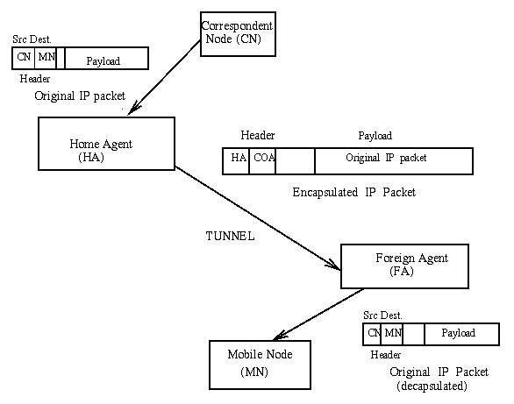
Current Design: Mobile IP

Slide 108
Problems with Mobile IP
Suboptimal “triangle” routing
What if MN is in same subnetwork as the node to which it is communicating and HA is on the other side of the world?
It would be nice if we could directly route packets
Solution: Let the CN know the COA of MN
Then the CN can create its own tunnel to MN
CN must be equipped with software to enable it to learn the COA
Initiated by HA who notifies CN via “binding update”
Binding table can become stale

Slide 109
Problems with Mobile IP
Single HA model is fragile
Possible solution – have multiple HA
Frequent reports to HA if MN is moving
Possible solution – support of FA clustering
Security
Connection hijacking, snooping…
Many open research questions

Slide 110
Mobility in IPv6
Route Optimization is a fundamental part of Mobile IPv6
Mobile IPv4 it is an optional set of extensions that may not be supported by all nodes
Foreign Agents are not needed in Mobile IPv6
MNs can function in any location without the services of any special router in that location
Security
Nodes are expected to employ strong authentication and encryption
Other details…

Slide 111
A More Extreme Design [MobilityFirst]
Separation of names and locators: Each host/service has a flat GUID (global unique ID), e.g., a secure hash of public key
A global name resolution service to find a set of network addresses (NAs)
Routing using using both names and network addresses, where the GUID name is considered to be the authoritative packet header
Notes:
, while routers may optionally use NAs for “fast path forwarding” after the GUID to NA bindings are determined at the first router along the path. In order to deal with dynamic connectivity changes, another option is late-binding in which a router may choose to rebind the GUID with NAs while a packet is in transit

Slide 112
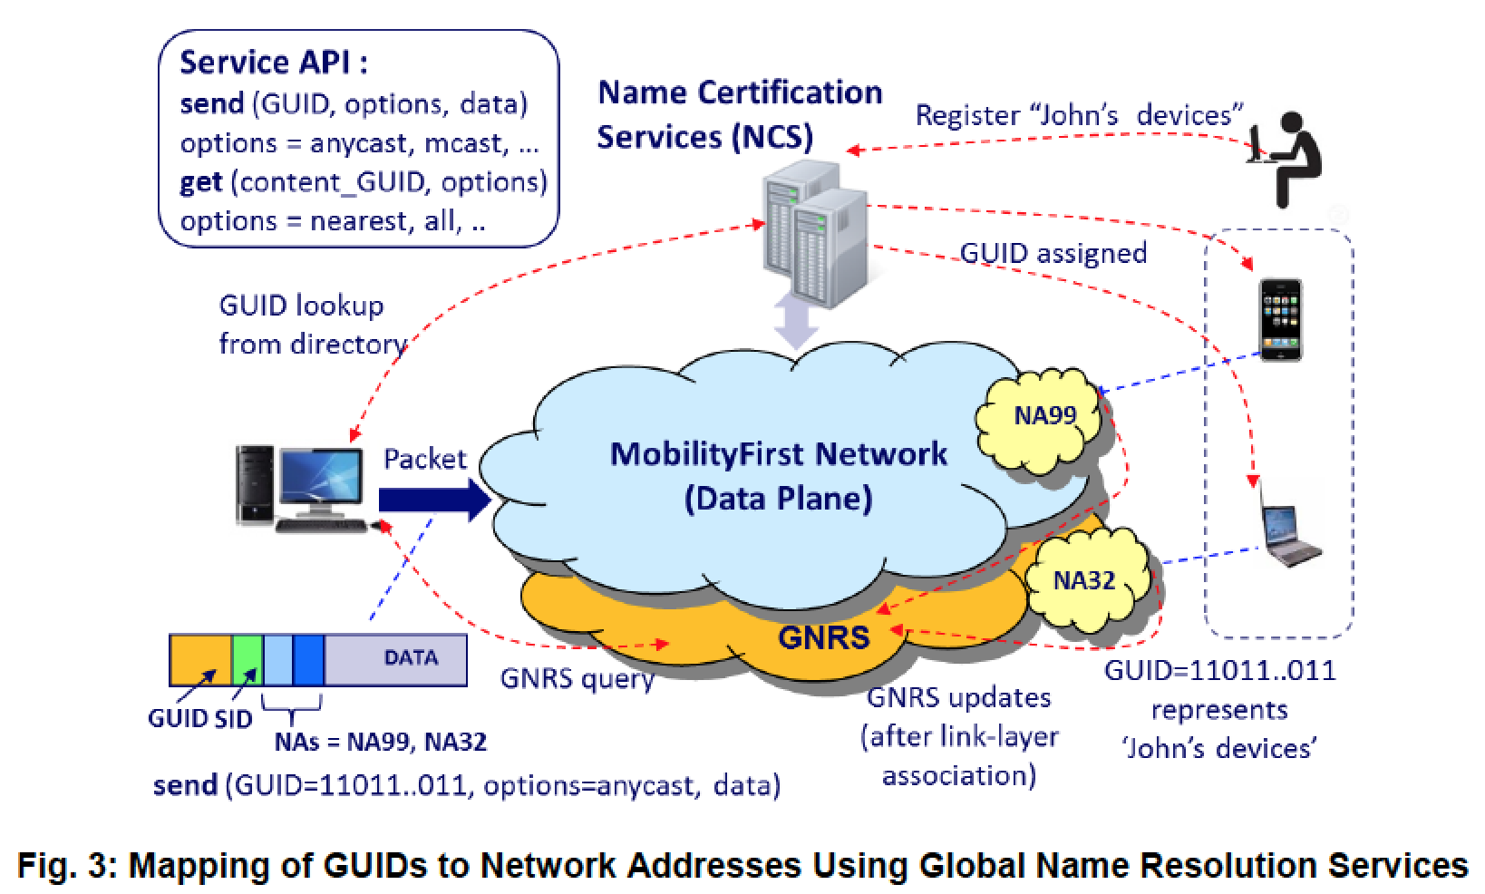
A More Extreme Design [MobilityFirst]

Slide 113
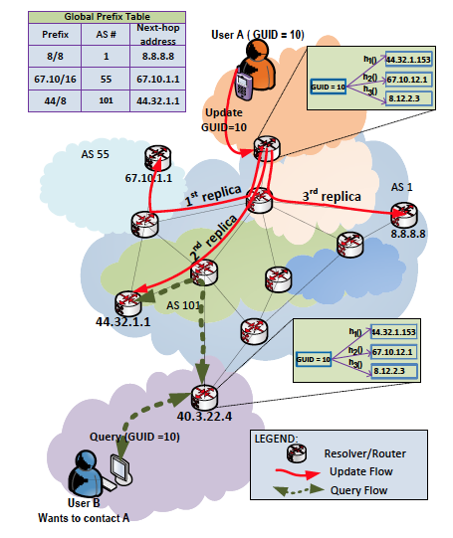
Key Issue: Global Name (ID) Lookup
Keep BGP routing
Each host hashes its GUID to an IP address, and the AS announcing the IP range hosts the lookup table
Do you buy this design?
Notes:
, while routers may optionally use NAs for “fast path forwarding” after the GUID to NA bindings are determined at the first router along the path. In order to deal with dynamic connectivity changes, another option is late-binding in which a router may choose to rebind the GUID with NAs while a packet is in transit

Slide 114
Named Data Networks (NDN): AKA Content Centric

Slide 115




Current Internet
ISP
ISP

Slide 116

An Alternative
ISP
ISP

Slide 117
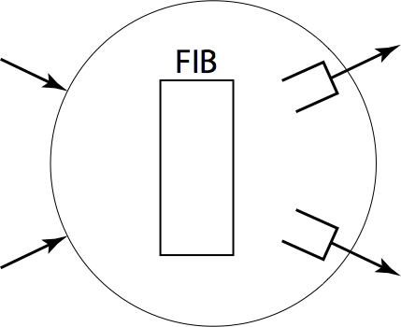

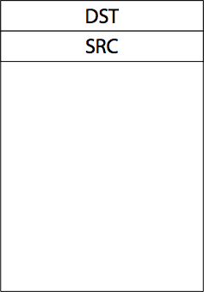
Router: Today
dst
src
Content lookup: Google -> URL -> DNS -> IP
Longest prefix match on IP address

Slide 118

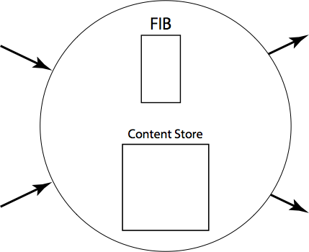
Router: Named Data Networks (NDN)
a/b
Producer
? a/b/c/e
Consumer
Router: Conducts both routing and content caching

Slide 119
Router: Named Data Networks (NDN)
level-1
level-2
level-3
level-4
level-5
/com/yahoo/news
/com/yahoo/music/new
/com/google/news
/com/google
/cn/com/sina/news
/cn/com/sina/mail
/cn/yahoo/news
news
8
yahoo
4
new
music
9
D
2
com
google
news
5
A
1
news
E
sina
cn
6
B
com
mail
F
3
yahoo
news
7
C
Name Prefix Trie (NPT)
Key idea: Routing on IP prefix -> Routing on Name prefix

Slide 120

Router: NDN
Do you buy this design?

Slide 121
Evolvability

Slide 122


Routers w/ Evolving Capabilities

Slide 123

Routers w/ Evolving Capabilities
https://www.usenix.org/sites/default/files/conference/protected-files/xia-nsdi2012-public.pdf

Slide 124

Basic Idea: Fallback and Intent

Slide 125

Basic Idea: DAG Based Addresses

Slide 126

More Possibilities
More secure
Quantum networks
Key exchange through physical properties instead of computational hardness
More economical
Cloud/edge integration
…
Source: https://en.wikipedia.org/wiki/Quantum_network#/media/File:BB84-network_setup.png
Due to quantum mechanics and the no-cloning theorem, Eve cannot eavesdrop and not being detected

Slide 127
First-Day Class: Evolution
Driven by Technology, Infrastructure, Policy, Applications (usage), and Understanding:
technology
e.g., wireless/optical communication technologies and device miniaturization (sensors)
infrastructure
e.g., cloud computing
Applications (usage)
e.g., mobility, content distribution, game, tele presence, sensing
understanding
e.g., resource sharing principle, routing principles, mechanism design, optimal stochastic control (randomized access)
Complexity comes from evolution.
Don’t be afraid to challenge the foundation and redesign!

Slide 128


